Slide 1
HR ANALYTICS | EMPLOYEE INSIGHTS
Employee Performance
& Productivity Analysis
Dashboard Insights • KPI Analysis • Scenario Modelling • HR Recommendations
PREPARED BY
K.B. Swetaa
Microsoft Excel | Power BI
EMPLOYEE PERFORMANCE & PRODUCTIVITY • HR ANALYTICS | 01

Slide 2
Executive Summary
A concise view of workforce performance, utilization and development opportunities
AVG PERFORMANCE RATING
AVG UTILIZATION
HIGH PERFORMERS
AVG TRAINING HOURS
3.31 / 5
55.35%
43.33%
10.96
WHAT THE ANALYSIS SHOWS
• The analysis evaluates employee performance, productivity, utilization, training hours and target achievement.
• Department-level views reveal differences in performance and productivity patterns.
• Scenario modelling tests how changes in training and target achievement could affect performance indicators.
• The dashboard supports targeted training, productivity management and workload planning.
Employee performance can be supported through targeted training, productivity management and appropriate workload planning.
EMPLOYEE PERFORMANCE & PRODUCTIVITY • HR ANALYTICS | 02

Slide 3
KPI Highlights
Baseline metrics and modeled scenario outcomes
AVERAGE PERFORMANCE
AVERAGE UTILIZATION
HIGH PERFORMER %
AVERAGE TRAINING
3.31 / 5
55.35%
43.33%
10.96 hrs
SCENARIO PERFORMANCE
SCENARIO UTILIZATION
SCENARIO TARGET ACHIEVEMENT
3.98
66.42%
85.24%
READOUT
Baseline performance is moderate, while the scenario model illustrates potential improvement under changed assumptions.
EMPLOYEE PERFORMANCE & PRODUCTIVITY • HR ANALYTICS | 03

Slide 4
Department-Wise Performance & Productivity
Comparing average performance ratings with productivity mix
Higher
Higher
HR
IT
Sales
Mktg
Cust. Supp.
Ops
Product
Finance
Ops
Cust.
Finance
IT
Mktg
Product
Sales
HR
HR, IT and Sales show relatively higher average ratings in the dashboard; Finance is comparatively lower.
Productivity is distributed across High, Low and Medium categories, creating scope for targeted interventions.
EMPLOYEE PERFORMANCE & PRODUCTIVITY • HR ANALYTICS | 04

Slide 5
Employee Productivity Analysis
Understanding the distribution of productivity categories
HIGH PRODUCTIVITY
MEDIUM PRODUCTIVITY
LOW PRODUCTIVITY
1
2
3
Smaller segment
Largest segment
Substantial segment
HR FOCUS
Identify → Understand → Intervene → Measure
Use the dashboard to locate productivity patterns, investigate contributing factors and monitor intervention outcomes.
EMPLOYEE PERFORMANCE & PRODUCTIVITY • HR ANALYTICS | 05

Slide 6
Training & Productivity Insights
Training-hour distribution and its HR implications
TRAINING HOURS DISTRIBUTION
MEDIUM
LOW
HIGH
57.92%
38.33%
3.75%
Medium
57.92%
Low
38.33%
• Average employee training hours: 10.96 hours.
• Most employees fall within the medium-training category.
• Only a small proportion receive high levels of training.
• HR can investigate whether targeted additional training supports productivity and performance.
High
3.75%
139 Medium • 92 Low • 9 High
EMPLOYEE PERFORMANCE & PRODUCTIVITY • HR ANALYTICS | 06

Slide 7
Monthly Employee Utilization Trend
Tracking workforce utilization across the review period
AVERAGE UTILIZATION
55.35%
PEAK SHOWN
60.66%
HR IMPLICATION
Review workload, staffing and project allocation when utilization changes materially.
Jan
Mar
May
Jul
Sep
Nov
EMPLOYEE PERFORMANCE & PRODUCTIVITY • HR ANALYTICS | 07

Slide 8
Star Performer Recognition
Employees combining strong performance ratings with high utilization
EMPLOYEE
DEPARTMENT
PERFORMANCE
UTILIZATION
Employee 211
Customer Support
5
81.48%
Employee 186
IT
4
81.33%
Employee 042
Product
4
80.33%
HR INSIGHT
These employees demonstrate relatively strong combinations of performance rating and utilization and can support recognition or knowledge-sharing initiatives.
EMPLOYEE PERFORMANCE & PRODUCTIVITY • HR ANALYTICS | 08

Slide 9
What-If & Scenario Analysis
Testing potential interventions before implementation
SCENARIO VARIABLES
SCENARIO RESULTS
Training Hours Change
0% → +20%
PERFORMANCE
UTILIZATION
TARGET ACHIEVEMENT
Target Achievement Change
0% → +15%
3.98
66.42%
85.24%
INTERPRETATION
• The scenario model allows HR to evaluate the potential effect of proposed changes before implementation.
• Changing assumptions provides a structured way to support data-driven workforce planning.
EMPLOYEE PERFORMANCE & PRODUCTIVITY • HR ANALYTICS | 09

Slide 10
HR Improvement Recommendations
Turning dashboard findings into practical interventions
Targeted Training
Provide additional training to employees in low-productivity or low-training categories.
01
Workload Balancing
Review workload distribution to improve utilization while avoiding excessive workload.
02
Mentoring & Knowledge Sharing
Encourage high-performing employees to share effective practices.
03
Department-Level Interventions
Design interventions specific to department-level performance patterns.
04
Continuous Monitoring
Track performance, utilization and productivity regularly through Power BI.
05
EMPLOYEE PERFORMANCE & PRODUCTIVITY • HR ANALYTICS | 10

Slide 11
From Insights to Action
A practical HR action framework
TRAINING
PRODUCTIVITY
WORKLOAD
Targeted skill development
Identify low-productivity employees
Review employee workload
Improve capability
Performance support
Better utilization
HIGH PERFORMERS
DEPARTMENTS
MONITORING
Recognition & mentoring
Department-specific interventions
Regular dashboard review
Knowledge sharing
Targeted improvement
Continuous tracking
From dashboard insight to measurable HR action.
EMPLOYEE PERFORMANCE & PRODUCTIVITY • HR ANALYTICS | 11

Slide 12
Conclusion
Key takeaways from the employee performance analysis
• The analysis provides a consolidated view of employee performance, productivity, utilization and training.
• The dashboard enables HR to identify performance patterns and areas requiring attention.
• Scenario analysis provides a way to evaluate potential interventions before implementation.
• Combining training, workload management, mentoring and continuous monitoring can support evidence-based HR decision-making.
FINAL MESSAGE
Data-driven HR decisions can transform employee performance insights into measurable workforce actions.
DATA
INSIGHT
ACTION
EMPLOYEE PERFORMANCE & PRODUCTIVITY • HR ANALYTICS | 12

Slide 13
Tools & Analytical Framework
Technology stack used to build the HR analytics deliverable
MICROSOFT EXCEL
MICROSOFT POWER BI
• Data preparation
• Data analysis
• Scenario-based analysis
• Interactive dashboard
• KPI visualization
• Department analysis
• What-If parameters
• Scenario analysis
ANALYTICAL AREAS
Performance • Productivity • Utilization • Training • Target Achievement • Employee Segmentation
EMPLOYEE PERFORMANCE & PRODUCTIVITY • HR ANALYTICS | 13

Slide 14
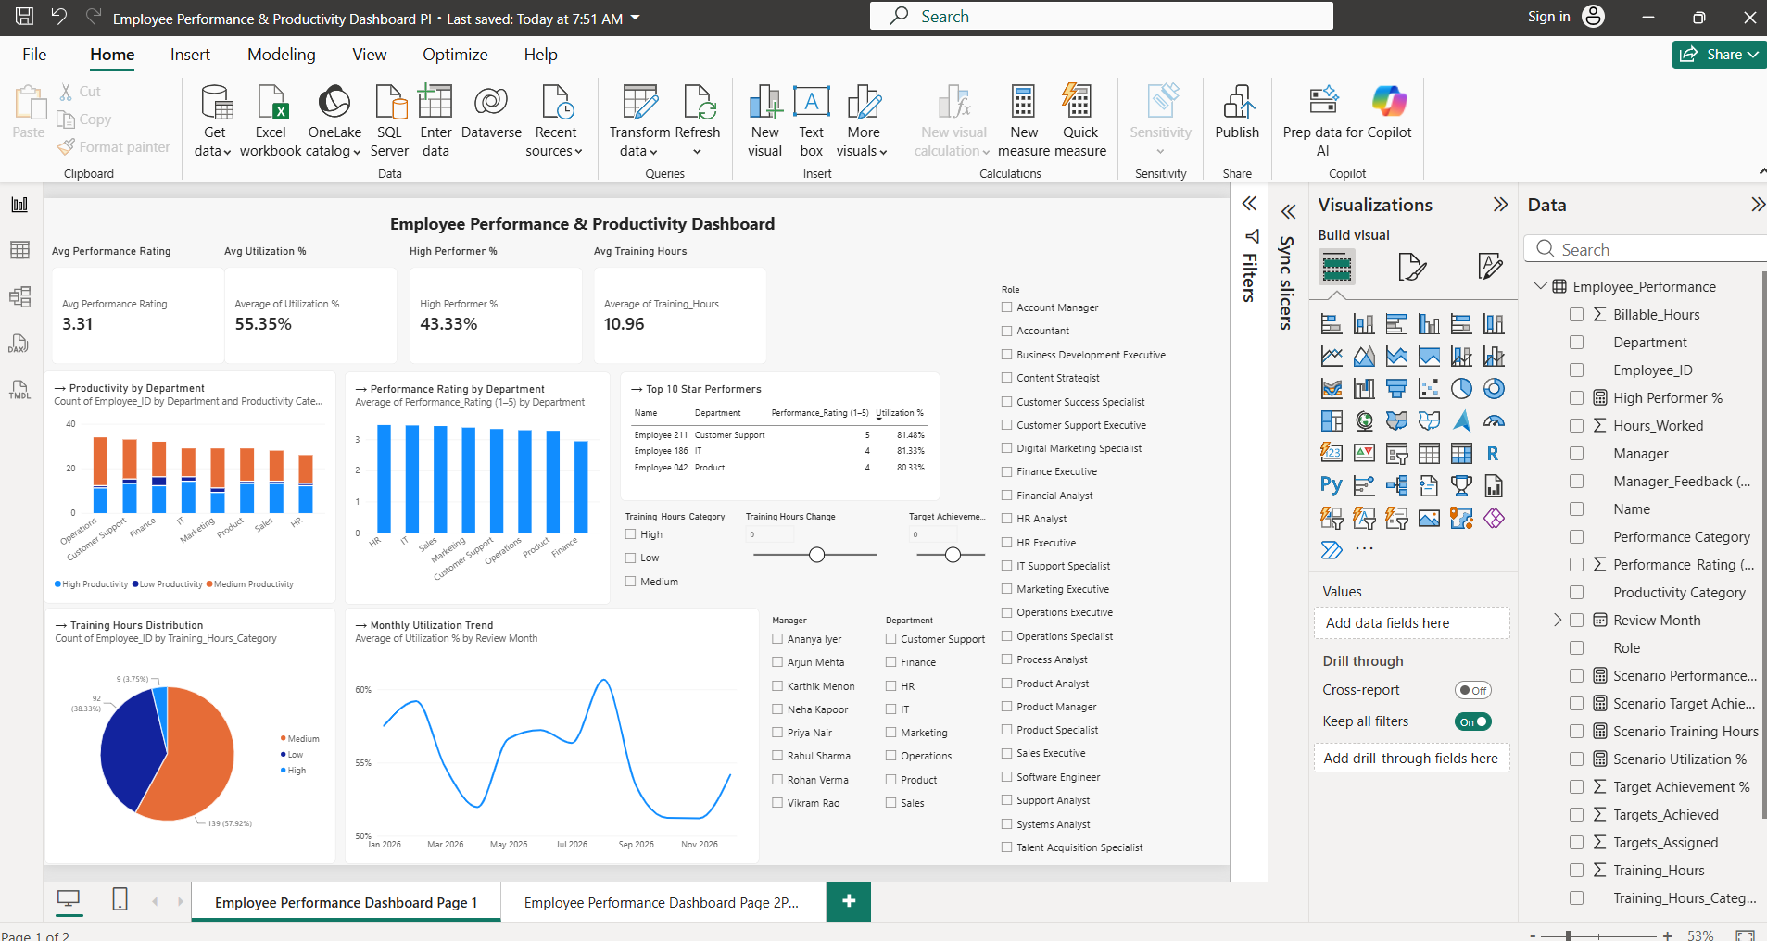

Slide 15
